Slide 1
UNIX SYSTEM PROGRAMMING
PROCESS

Slide 2
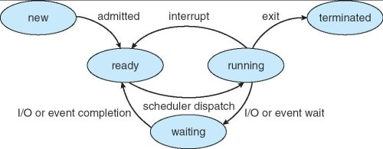
Process States

Slide 3
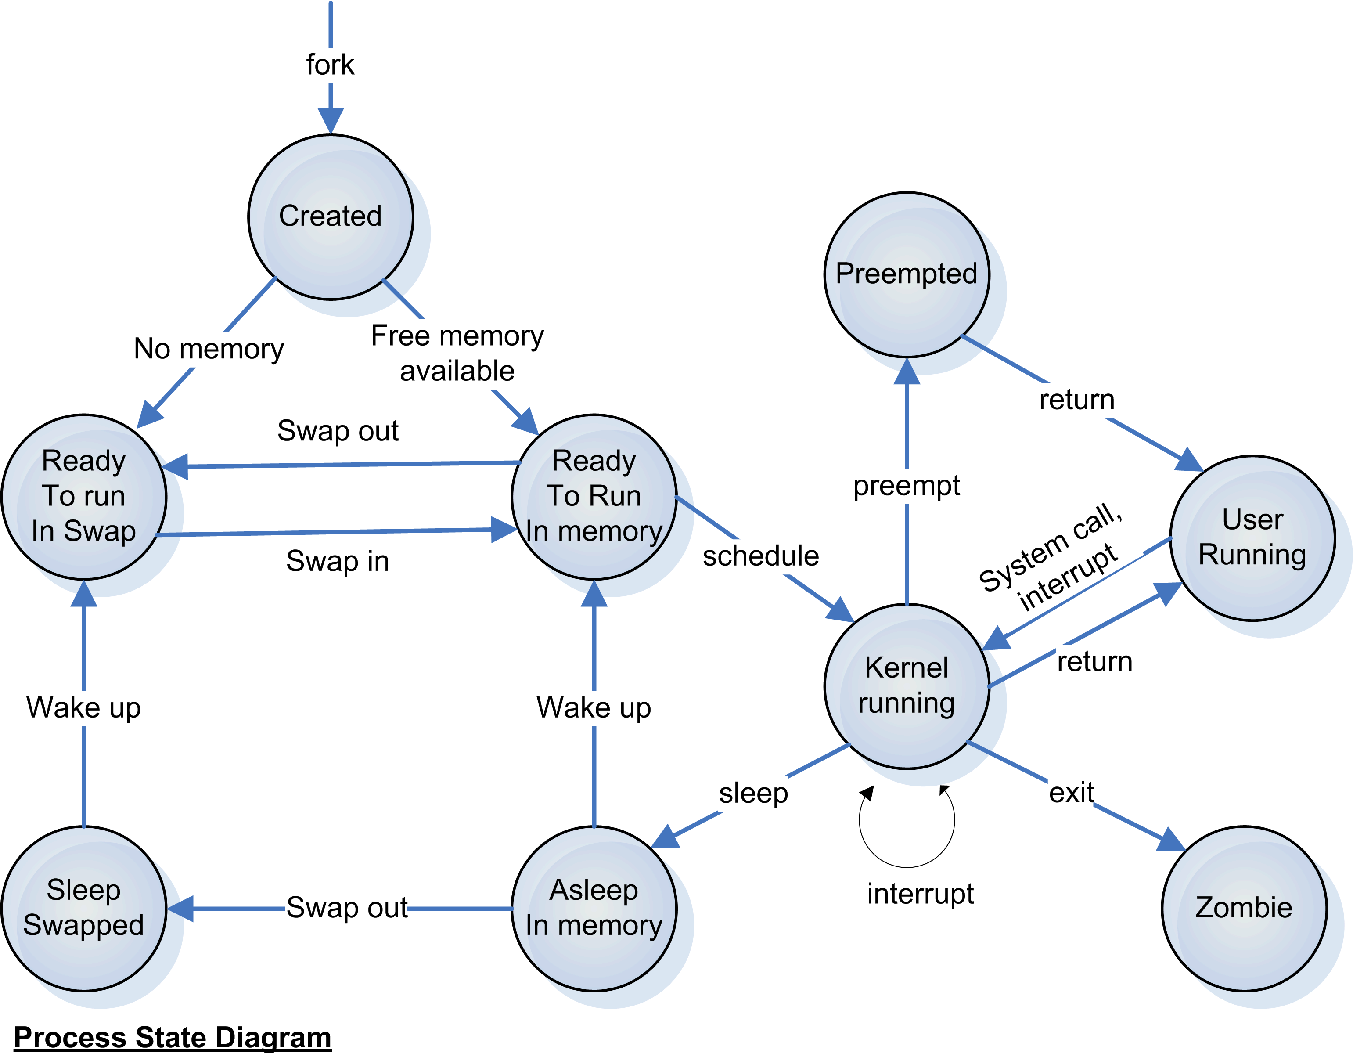
Process State in unix

Slide 5
PID and PPID
Every process has a unique ID called Process ID. To get process ID, we use getpid()
Every process has a parent, to get the parents process ID, we use getppid();
int main()
{
printf(“PID = %d “ , getpid( ));
printf(“PARENT PID = %d “ , getppid( ));
}
Notes:
Any running program is called a process. There can be multiple processes of a single program.
1Getpid.c
The parent of our program is shell.

Slide 6
Create a child process
int fork(void);

Slide 7
Main()
{
fork();
fork();
printf(“CRANES”);
}

Slide 8
Main()
{
fork();
fork();
fork();
printf(“CRANES”);
}

Slide 9
Main()
{
printf(“A\n”);
fork();
printf(“B\n”);
fork();
printf(“C\n”);
fork();
printf(“D\n”);
}

Slide 10
Creating a child
P1.c
int main()
{
printf(“START OF PROGRAM “);
fork( );
printf(“END OF PROGRAM “);
}
Parent
3. Pf
Fork
5.pf
Child
5.pf
Output
START OF PROGRAM
END OF PROGRAM
END OF PROGRAM
Notes:
2fork.c
#include <sys/types.h>
#include <unistd.h>
int main()
{
printf("BEGINING OF PROGRAM \n");
fork();
printf("END OF PROGRAM \n");
}

Slide 11
How to determine parent and child process
Using return value of fork
0 – child process
Non-zero (pid of child) – parent process
int main()
{
int x ;
printf(“START OF PROGRAM “);
x = fork( );
if(x == 0)
printf(“CHILD PROCESS“);
else
printf(“PARENT PROCESS“);
}
Notes:
START OF PROGRAM
CHILD PROCESS
PARENT PROCESS
1 #include <stdio.h>
2 #include <unistd.h>
3 #include <sys/types.h>
4 int main()
5 {
6 int x = 5;
7 printf("START OF PROGRAM \n");
8 printf("parent - %d %d \n" ,getpid(),getppid());
9 x = fork();
10
11 printf("%d %d x = %d \n" ,getpid(),getppid(),x);
12 printf("END OF PROGRAM \n");
13 sleep(8);
14 }

Slide 12
#include <unistd.h>
#include <sys/types.h>
int main()
{
int x = 5;
printf("parent - %d %d \n" ,getpid(),getppid());
x = fork();
printf("%d %d x = %d \n" ,getpid(),getppid(),x);
printf("END OF PROGRAM \n");
sleep(8);
}
Notes:
Sleep is used so that I can run in background and also use ps –f command
[1] 16459
START OF PROGRAM
[sikander@localhost process]$
parent - 16459 16300 //line - 8
16460 16459 x = 0 //line – 11 of child
END OF PROGRAM //line – 12 of child
16459 16300 x = 16460 //line – 11 of parent
END OF PROGRAM //line 12 of child
ps -f
UID PID PPID C STIME TTY TIME CMD
sikander 16300 16299 0 15:30 pts/7 00:00:00 -bash
sikander 16459 16300 0 15:44 pts/7 00:00:00 ./3forkhierarchy
sikander 16460 16459 0 15:44 pts/7 00:00:00 ./3forkhierarchy
sikander 16461 16300 0 15:44 pts/7 00:00:00 ps -f

Slide 13
[sikander@localhost process]$ ./fork1 &
[1] 16459
START OF PROGRAM
[sikander@localhost process]$
parent - 16459 16300 //line - 8
16460 16459 x = 0 //line – 11 of child
16459 16300 x = 16460 //line – 11 of parent
ps -f
UID PID PPID C STIME TTY TIME CMD
sikander 16300 16299 0 15:30 pts/7 00:00:00 -bash
sikander 16459 16300 0 15:44 pts/7 00:00:00 ./fork1
sikander 16460 16459 0 15:44 pts/7 00:00:00 ./fork1
sikander 16461 16300 0 15:44 pts/7 00:00:00 ps -f
Notes:
Shell PID – 16300
./fork1 and ps –f are executed from shell. Shell is the parent of these 2 process(purple colour).
The pid of ./fork1 is 16459 and pid of ps is 16461
The child is created from ./fork1 (16459)
The id of new child is 16460 and its parent is 16459.

Slide 14
16299
Bash : 16300
./fork1 : 16459
Ps : 16461
./fork1 : 16460

Slide 15
Segments shared between parent and child
Parent and Child process share the code/text segment
Child copies DATA , STACK and Heap Segment
Child : Before update
Data Seg: global = 1
Stack Seg : local = 2
Parent
Data Seg: global = 1
Stack Seg : local = 2
Child : After update
Data Seg: global = 6
Stack Seg : local = 7

Slide 16
Segments shared between parent and child
Parent and Child process share DATA , STACK and Heap Segment
int global = 1;
int main()
{
int local = 2;
printf("PARENT %d \n",getpid());
int x = fork();
if(x == 0)
{
printf("CHILD PROCESS %d \n" , getpid());
global = global + 5;
local = local + 5;
}
printf("PID = %d global = %d local = %d \n" ,getpid(), global,local);
}
Notes:
Prgoram : 4fork_pc_sharedseg.c
parent - 16879 16300
x = 0 global = 6 local = 7 //updated in child
x = 16880 global = 1 local = 2 // not updated in parent.
#include <sys/types.h>
#include <unistd.h>
int global = 1;
int main()
{
int local = 2;
printf("PARENT %d \n",getpid());
int x = fork();
if(x == 0)
{
printf("CHILD PROCESS %d \n" , getpid());
global = global + 5;
local = local + 5;
}
printf("PID = %d global = %d local = %d \n" ,getpid(), global,local);
}

Slide 17
Program to demonstrate child has separate instance of heap segment.
int main()
{
int *ptr = malloc(4);
*ptr = 5;
printf("PARENT %d \n",getpid());
int x = fork();
if(x == 0)
{
printf("CHILD PROCESS %d \n" , getpid());
*ptr = *ptr + 5;
}
printf("PID = %d *ptr = %d \n" ,getpid(), *ptr);
}

Slide 18
wait
Wait – waits for the child process to terminate.
if(fork() == 0 ) {
printf("CHILD PROCESS \n");
sleep(2);
printf(“END OF CHILD \n”);
}
else {
printf("PARENT PROCESS \n");
#ifdef WAIT
wait( 0 );
#endif
printf(“END OF PARENT \n”);
}
Notes:
Program : wait1.c Program to demonstrate parent process waiting for the completion of child process.
[sikander@localhost process]$ gcc wait1.c
[sikander@localhost process]$ ./a.out
CHILD PROCESS
PARENT PROCESS
END OF PARENT
END OF CHILD
// Parent ends before child
[sikander@localhost process]$ gcc wait1.c -DWAIT
[sikander@localhost process]$ ./a.out
parent - 18859 16300
CHILD PROCESS
PARENT PROCESS
END OF CHILD
END OF PARENT //Parent waits will the child ends.

Slide 19
Collect exit status of child
Wait(int *status);
x = fork( );
if(x == 0) {
printf("CHILD PROCESS \n");
return 4; //the returned value is collected by wait.
}
else {
printf("PARENT PROCESS \n");
int exitstatus;
wait(&exitstatus);
printf("child exit status = %x \n" , exitstatus >> 8);
}
printf("WEXITSTATUS %d \n" , WEXITSTATUS(exitstatus));
Notes:
Program : wait2.c Program to demonstrate parent process collecting the return status of child process.
Program : wexitstatus.c

Slide 20
waitpid
int main( ) {
int c1 = fork();
if(c1 == 0) {
return 5;
}
int c2 = fork();
if(c2 == 0) {
return 8;
}
int exitstatus;
waitpid(c1 , &exitstatus,WUNTRACED);
printf("child exit status = %x \n" , exitstatus >> 8);
}
Notes:
Replace c1 with c2 to collect exitstatus of child 2.

Slide 21
Invoke other process using exec
int execl(const char *path, const char *arg, ...);
int execlp(const char *file, const char *arg, ...);
int execv(const char *path, char *const argv[]);
int execvp(const char *file, char *const argv[]);
Return value :
-1 – On Failure
Does not return on success.
Notes:
x = execl("ls","ls","-l" ,NULL); returns -1
x = execl("/bin/ls","ls","-l" ,NULL);

Slide 22
Invoke other process using exec
int execl(const char *path, const char *arg, ...);
int execlp(const char *file, const char *arg, ...);
int execv(const char *path, char *const argv[]);
int execvp(const char *file, char *const argv[]);
execl(“/bin/ls”,”ls”, “-l” , NULL);
execlp(“ls”, “ls”,”-l” , NULL);
Notes:
x = execl("ls","ls","-l" ,NULL); returns -1
x = execl("/bin/ls","ls","-l" ,NULL);

Slide 23
Invoke other process using exec
int main()
{
int x = 5;
printf("START OF PROGRAM \n");
x = fork();
if(x == 0)
{
printf("CHILD PROCESS \n");
x = execl(“/bin/ls",”ls",”-l" ,NULL);
printf("return value of execl = %d \n",x);
}
else
{
printf("PARENT PROCESS \n");
}
}
Notes:
When exec is successful, it will not return.
When exec is unsuccessful, it will not return -1.

Slide 24
Invoke other process using exec
int main()
{
int x = 5;
printf("START OF PROGRAM \n");
x = fork();
if(x == 0)
{
x = execlp(“ls",”ls",”-l" ,NULL);
printf("return value of execl = %d \n",x);
}
else
{
printf("PARENT PROCESS \n");
}
}
Notes:
When exec is successful, it will not return.
When exec is unsuccessful, it will not return -1.

Slide 25
Invoke other process using exec
int main()
{
int x = 5;
printf("START OF PROGRAM \n");
x = fork();
if(x == 0)
{
char *argv[] = {“ls”,”-l”,NULL};
x = execvp(“ls“,argv);
printf("return value of execl = %d \n",x);
}
else
{
printf("PARENT PROCESS \n");
}
}
Notes:
When exec is successful, it will not return.
When exec is unsuccessful, it will not return -1.

Slide 26
int data = 10;
int main()
{
int x = 0;
#ifdef VFORK
x = vfork();
#else
x = fork();
#endif
if(x == 0) {
data = 20;
printf("Child data = %d \n",data);
exit(0);
}
else {
printf("Parent data = %d \n",data);
data = 40;
printf("Parent data = %d \n",data);
}
}

Slide 27
Fork and vfork
PARENT
TEXT
DATA
STACK
CHILD
TEXT
DATA
STACK
PARENT
TEXT
DATA
STACK
CHILD
TEXT
DATA
STACK

Slide 28
Setpgrp
Return value of wait

